Slide 1

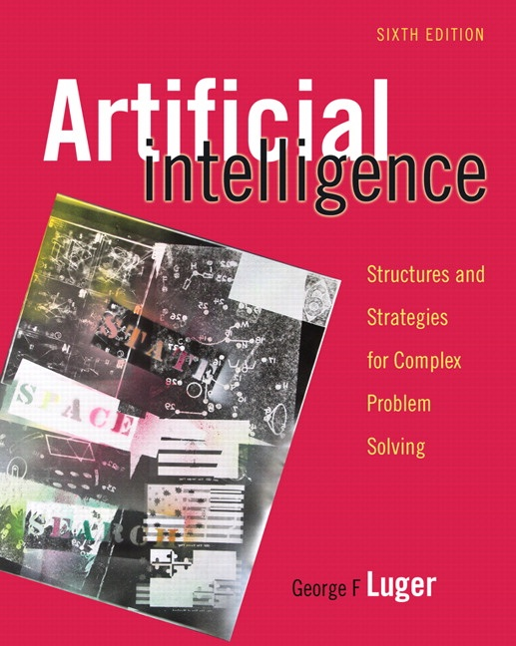
HEURISTIC SEARCH
4.0 Introduction
4.1 An Algorithm for Heuristic Search
4.2 Admissibility, Monotonicity, and Informedness
4.3 Using Heuristics I n Games
4.4 Complexity Issues
4.5 Epilogue and References
4.6 Exercises
George F Luger
ARTIFICIAL INTELLIGENCE 6th edition
Structures and Strategies for Complex Problem Solving
Luger: Artificial Intelligence, 6th edition. © Pearson Education Limited, 2009

Slide 2
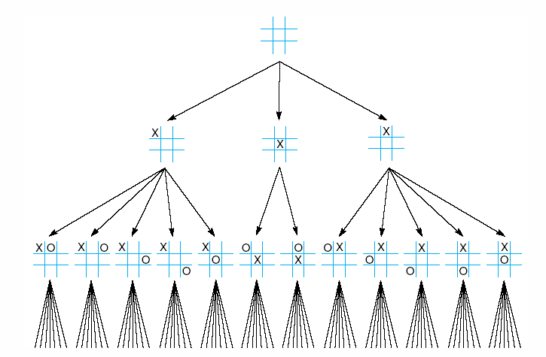
Fig 4.1 First three levels of the tic-tac-toe state space reduced by symmetry
Luger: Artificial Intelligence, 6th edition. © Pearson Education Limited, 2009

Slide 3
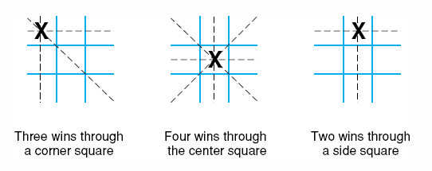
Fig 4.2 The “most wins” heuristic applied to the first children in tic-tac-toe.
Luger: Artificial Intelligence, 6th edition. © Pearson Education Limited, 2009

Slide 4
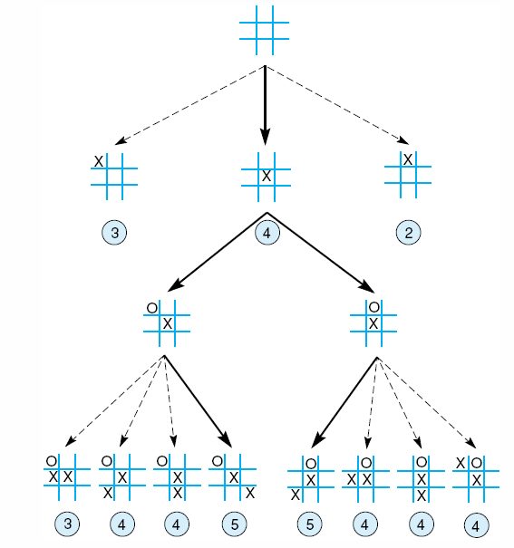
Fig 4.3 Heuristically reduced state space for tic-tac-toe.
Luger: Artificial Intelligence, 6th edition. © Pearson Education Limited, 2009

Slide 5
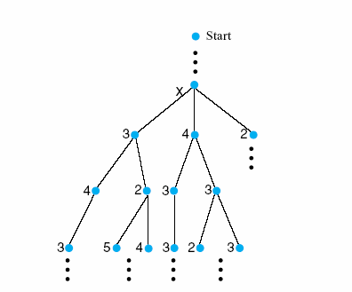
Fig 4.4 The local maximum problem for hill-climbing with 3-level look ahead
Luger: Artificial Intelligence, 6th edition. © Pearson Education Limited, 2009
Notes:
Insert fig 4.4

Slide 6

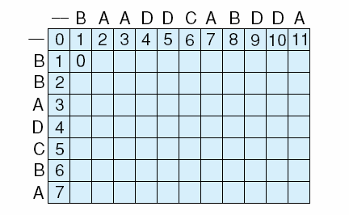
Fig 4.5 The initialization stage and first step in completing the array for character alignment using dynamic programming.
Luger: Artificial Intelligence, 6th edition. © Pearson Education Limited, 2009
Notes:
Insert fig 4.5 WITH BAADDCABDDA
BBADC B A

Slide 7
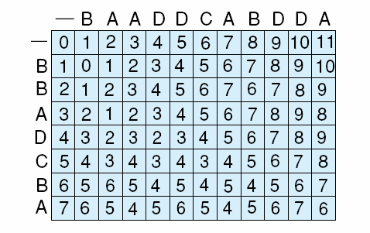
Fig 4.6 The completed array reflecting the maximum alignment information for the strings.
Luger: Artificial Intelligence, 6th edition. © Pearson Education Limited, 2009

Slide 8
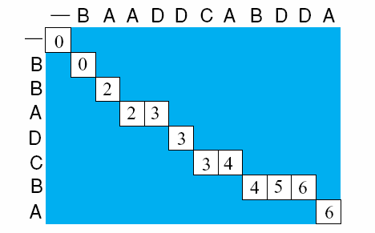
Fig 4.7 A completed backward component of the dynamic programming example giving one (of several possible) string alignments.
Luger: Artificial Intelligence, 6th edition. © Pearson Education Limited, 2009

Slide 9
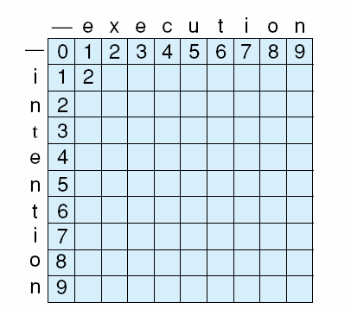
Fig 4.8 Initialization of minimum edit difference matrix between intention and execution (adapted from Jurafsky and Martin, 2000).
Luger: Artificial Intelligence, 6th edition. © Pearson Education Limited, 2009
Notes:
Insert fig 4.8

Slide 10
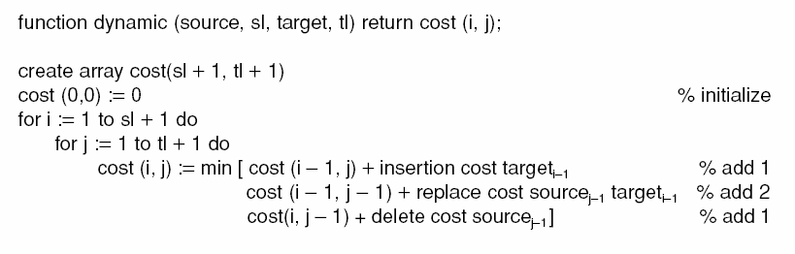
Luger: Artificial Intelligence, 6th edition. © Pearson Education Limited, 2009

Slide 11
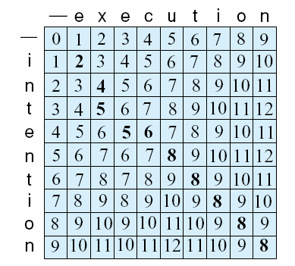
Fig 4.9 Complete array of minimum edit difference between intention and execution (adapted from Jurafsky and Martin, 2000) (of several possible) string alignments.
Intention
ntention delete I, cost 1
etention replace n with e, cost 2
exention replace t with x, cost 2
exenution insert u, cost 1
execution replace n with c, cost 2
Luger: Artificial Intelligence, 6th edition. © Pearson Education Limited, 2009

Slide 12
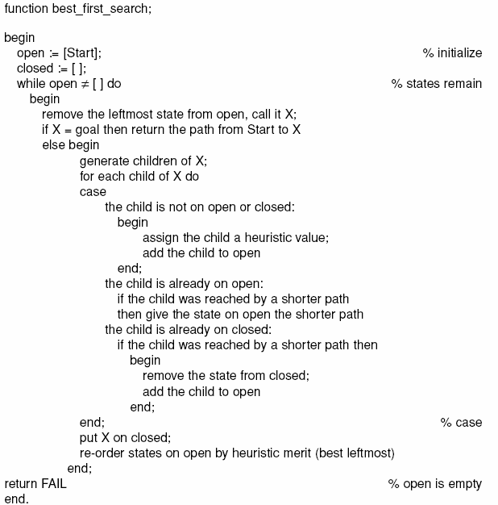
Luger: Artificial Intelligence, 6th edition. © Pearson Education Limited, 2009

Slide 13
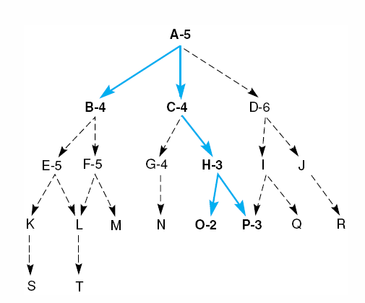
Fig 4.10 Heuristic search of a hypothetical state space.
Luger: Artificial Intelligence, 6th edition. © Pearson Education Limited, 2009

Slide 14
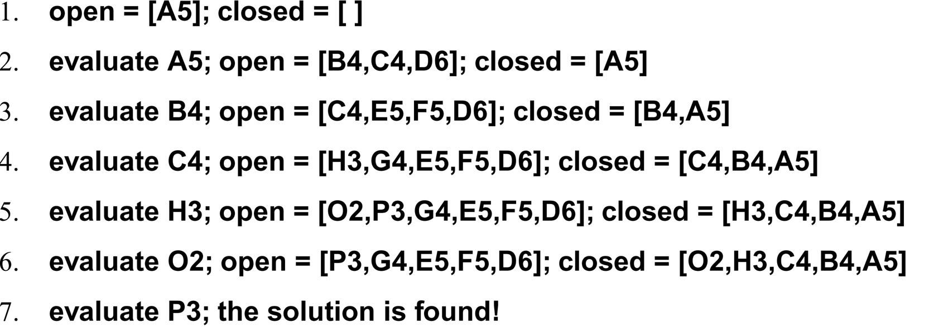
A trace of the execution of best_first_search for Figure 4.4
Luger: Artificial Intelligence, 6th edition. © Pearson Education Limited, 2009

Slide 15
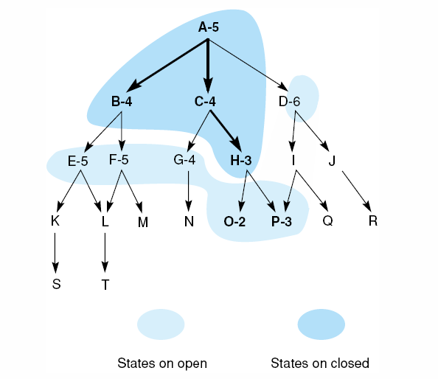
Fig 4.11 Heuristic search of a hypothetical state space with open and closed states highlighted.
Luger: Artificial Intelligence, 6th edition. © Pearson Education Limited, 2009

Slide 16
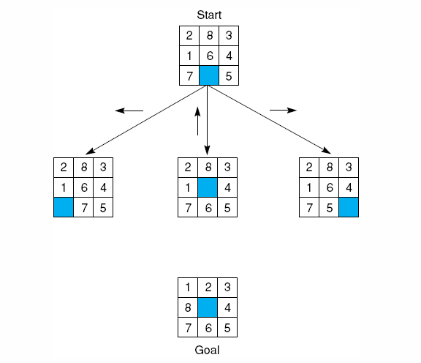
Fig 4.12 The start state, first moves, and goal state for an example-8 puzzle.
Luger: Artificial Intelligence, 6th edition. © Pearson Education Limited, 2009
Notes:
Insert fig 4.12

Slide 17
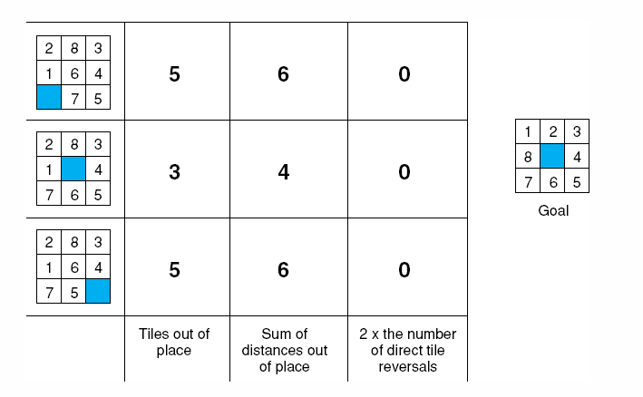
Fig 4.14 Three heuristics applied to states in the 8-puzzle.
Luger: Artificial Intelligence, 6th edition. © Pearson Education Limited, 2009

Slide 18
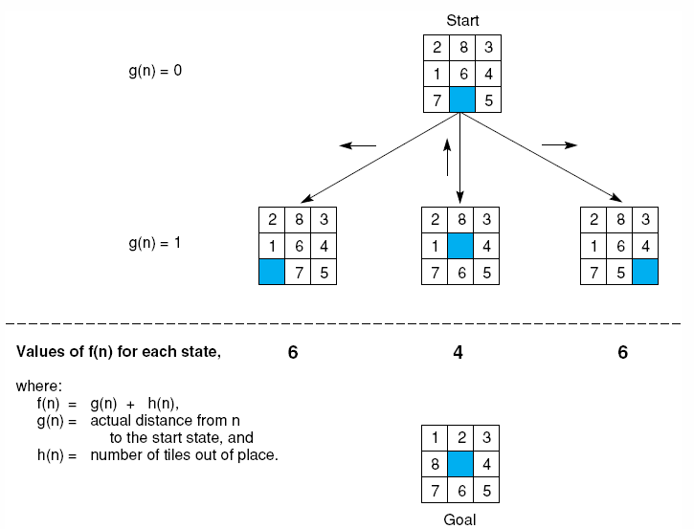
Fig 4.15 The heuristic f applied to states in the 8-puzzle.
Luger: Artificial Intelligence, 6th edition. © Pearson Education Limited, 2009
Notes:
Insert fig 4.15

Slide 19
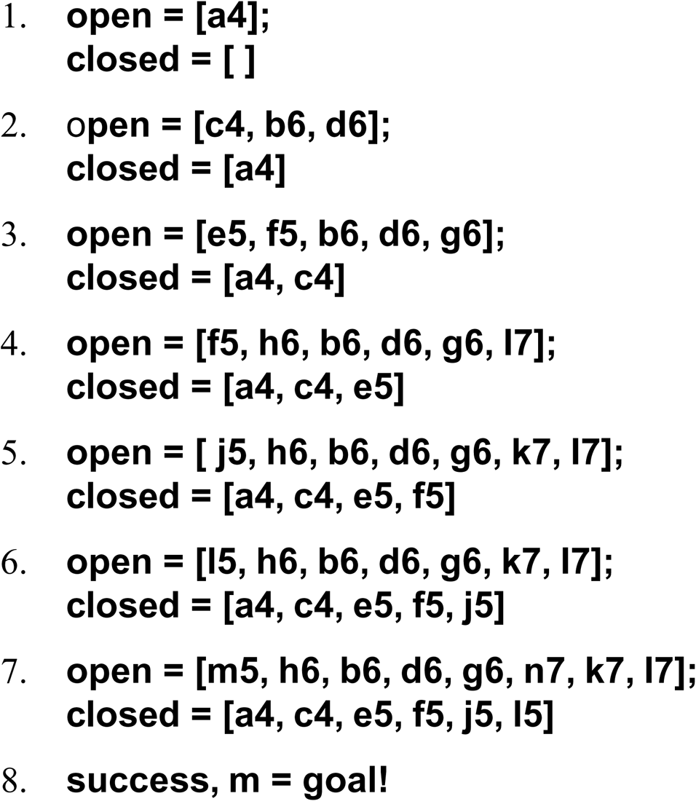
The successive stages of open and closed that generate this graph are:
Luger: Artificial Intelligence, 6th edition. © Pearson Education Limited, 2009

Slide 20
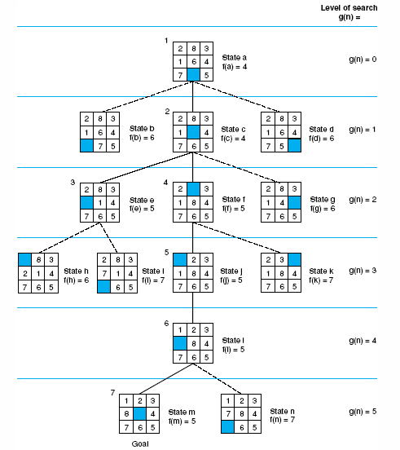
Fig 4.16 State space generated in heuristic search of the 8-puzzle graph.
Luger: Artificial Intelligence, 6th edition. © Pearson Education Limited, 2009
Notes:
Insert fig 4.16

Slide 21
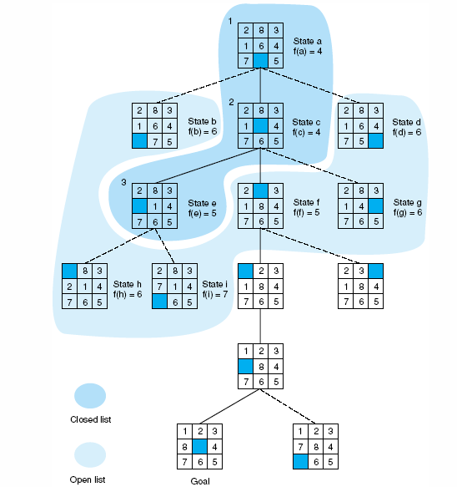
Fig 4.17 Open and closed as they appear after the 3rd iteration of heuristic search
Luger: Artificial Intelligence, 6th edition. © Pearson Education Limited, 2009

Slide 22
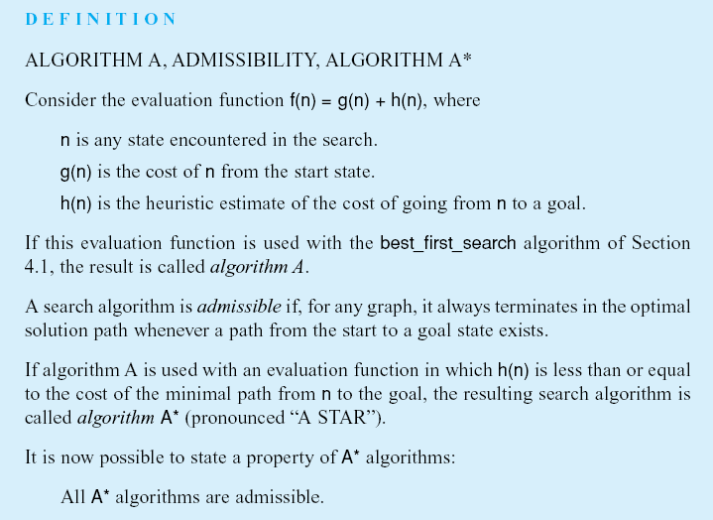
Luger: Artificial Intelligence, 6th edition. © Pearson Education Limited, 2009
Notes:
Insert def box page 146

Slide 23
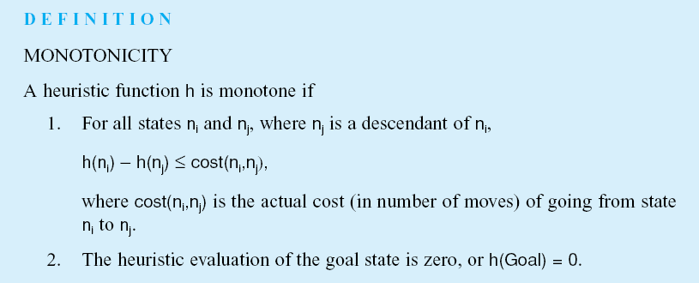
Luger: Artificial Intelligence, 6th edition. © Pearson Education Limited, 2009
Notes:
Insert def box, pg 147

Slide 24
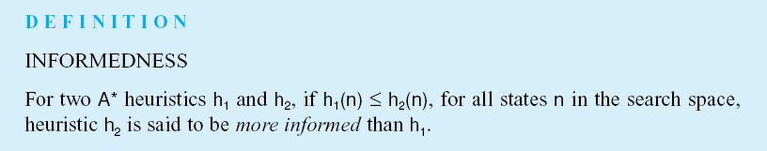
Luger: Artificial Intelligence, 6th edition. © Pearson Education Limited, 2009
Notes:
Insert def box, pg 148

Slide 25
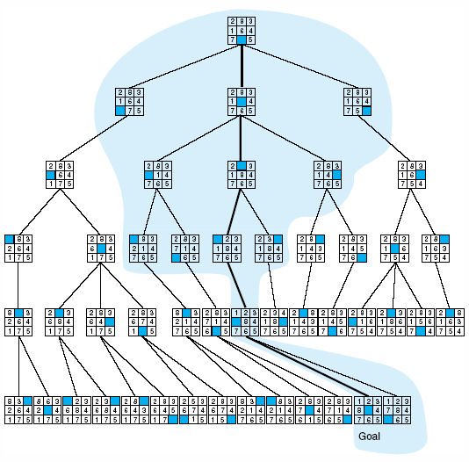
Fig 4.18 Comparison of state space searched using heuristic search with space searched by breadth-first search. The proportion of the graph searched heuristically is shaded. The optimal search selection is in bold. Heuristic used is f(n) = g(n) + h(n) where h(n) is tiles out of place.
Luger: Artificial Intelligence, 6th edition. © Pearson Education Limited, 2009

Slide 26
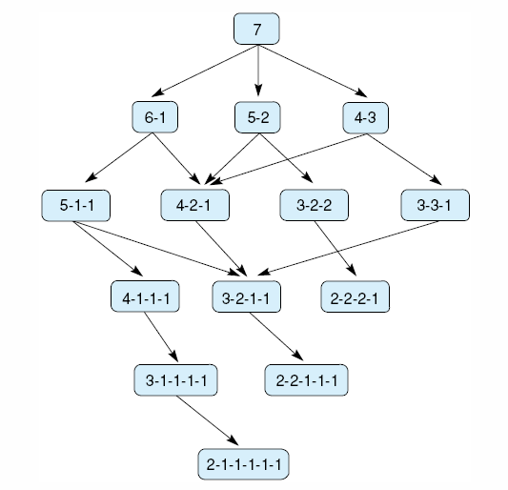
Fig 4.19 State space for a variant of nim. Each state partitions the seven matches into one or more piles.
Luger: Artificial Intelligence, 6th edition. © Pearson Education Limited, 2009

Slide 27
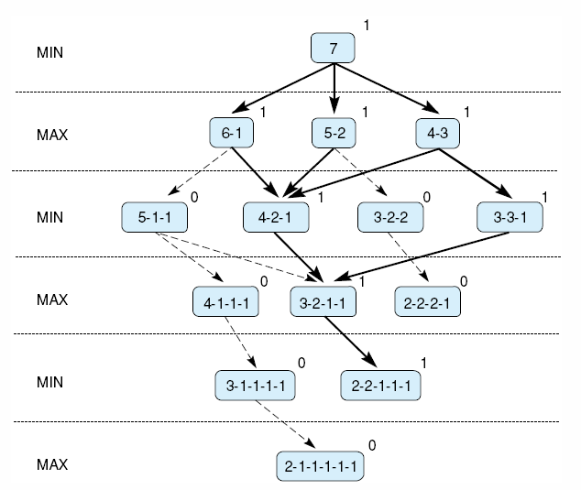
Fig 4.20 Exhaustive minimax for the game of nim. Bold lines indicate forced win for MAX. Each node is marked with its derived value (0 or 1) under minimax.
Luger: Artificial Intelligence, 6th edition. © Pearson Education Limited, 2009
Notes:
Insert fig 4.20

Slide 28
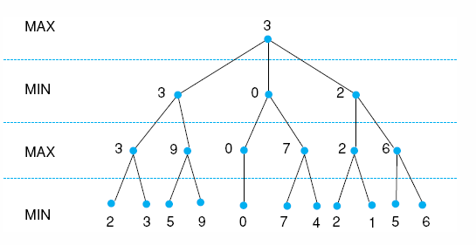
Fig 4.21 Minimax to a hypothetical state space. Leafstates show heuristic values; internal states show backed-up values.
Luger: Artificial Intelligence, 6th edition. © Pearson Education Limited, 2009
Notes:
Insert fig 4.21

Slide 29
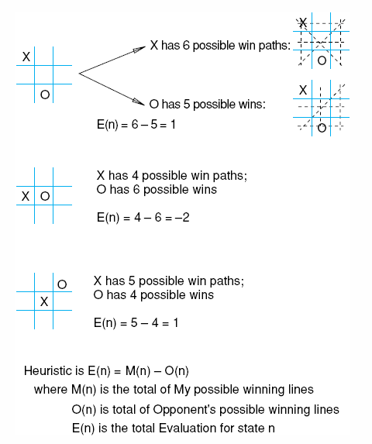
Fig 4.22 Heuristic measuring conflict applied to states of tic-tac-toe.
Luger: Artificial Intelligence, 6th edition. © Pearson Education Limited, 2009

Slide 30
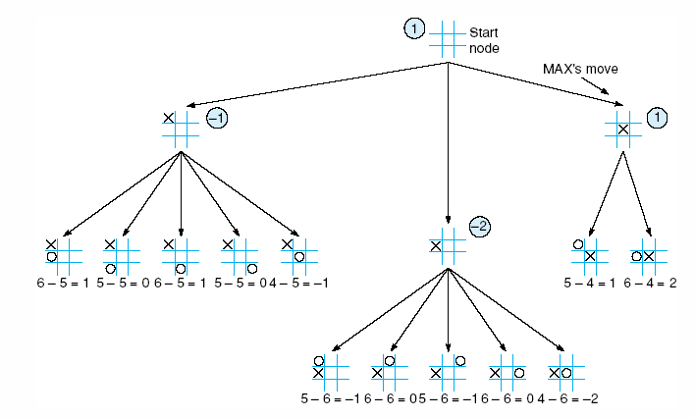
Fig 4.23 Two-ply minimax applied to the opening move of tic-tac-toe, from Nilsson (1971).
Luger: Artificial Intelligence, 6th edition. © Pearson Education Limited, 2009

Slide 31
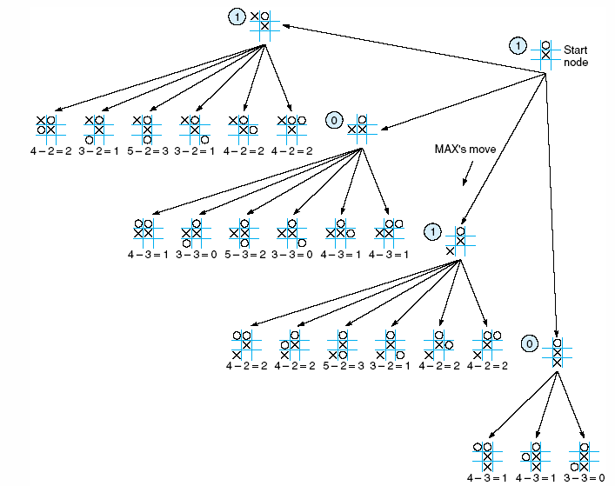
Fig 4.24 Two ply minimax, and one of two possible MAX second moves, from Nilsson (1971).
Luger: Artificial Intelligence, 6th edition. © Pearson Education Limited, 2009

Slide 32
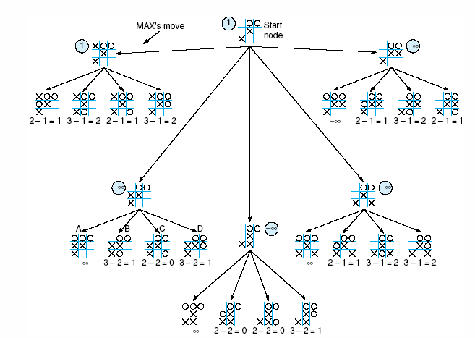
Fig 4.25 Two-ply minimax applied to X’s move near the end of the game, from Nilsson (1971).
Luger: Artificial Intelligence, 6th edition. © Pearson Education Limited, 2009

Slide 33
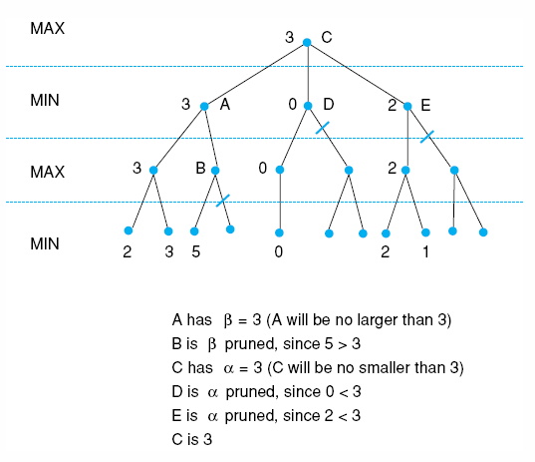
Fig 4.26 Alpha-beta pruning applied to state space of Fig 4.21. States without numbers are not evaluated.
Luger: Artificial Intelligence, 6th edition. © Pearson Education Limited, 2009

Slide 34
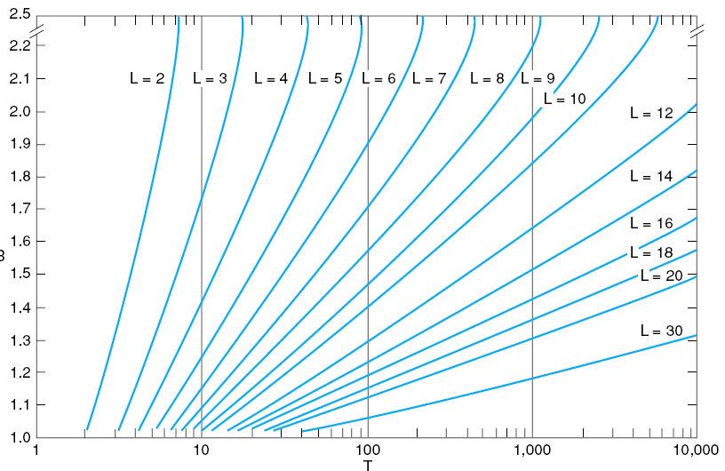
Fig 4.27 Number of nodes generated as a function of branching factor, B, for various lengths, L, of solution paths. The relating equation is T = B(B^{L} – 1)/(B – 1), adapted from Nilsson (1980).
Luger: Artificial Intelligence, 6th edition. © Pearson Education Limited, 2009

Slide 35
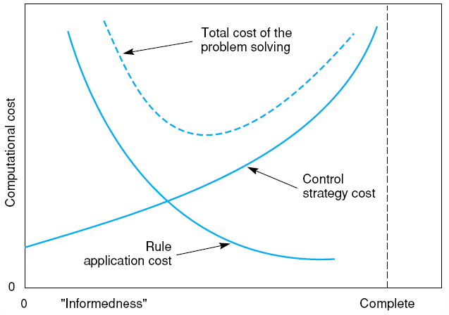
Fig 4.28 Informal plot of cost of searching and cost of computing heuristic evaluation against informedness of heuristic, adapted from Nilsson (1980).
Luger: Artificial Intelligence, 6th edition. © Pearson Education Limited, 2009

Slide 36

Fig 4.29 The sliding block puzzle.
Luger: Artificial Intelligence, 6th edition. © Pearson Education Limited, 2009

Slide 37
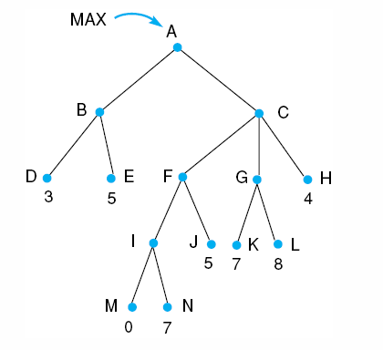
Fig 4.30.
Luger: Artificial Intelligence, 6th edition. © Pearson Education Limited, 2009

Slide 38
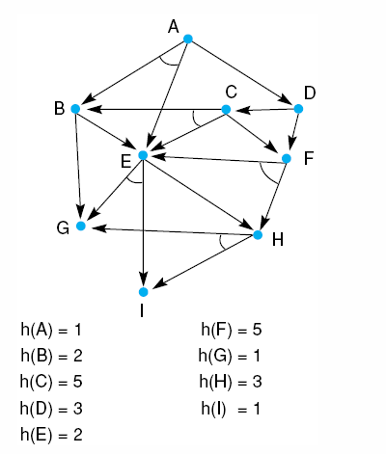
Fig 4.31.
Luger: Artificial Intelligence, 6th edition. © Pearson Education Limited, 2009

